Slide 1
Assingment Two Part One
By Wayde Fagan and Chisomo Sibande
“The Greatest Team”

Slide 2
But first… an overview
The program
Things that we took into consideration
Principles of Design
Our design
Class Diagram
Sequence Diagram

Slide 3
The Program

Slide 4
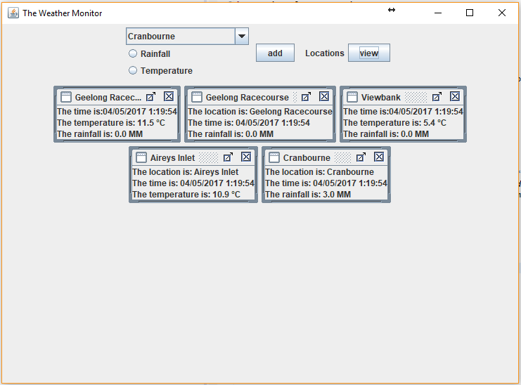
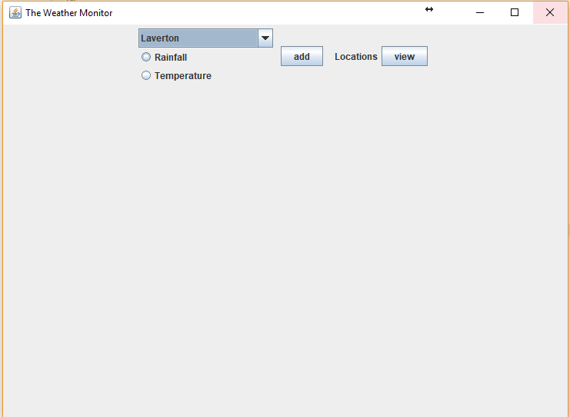

Slide 5
Things that we took into consideration

Slide 6
Demands of the current program
The length of the program
Cohesion and coupling of the classes
The number of variables
Graphic design
Have to extend on the current code

Slide 7
Principles of Design

Slide 8
The principles we used
Common reuse principle
Java Swing
Java Utility
Java Language
Imported the package: Melbourne Weather Stub 25
Which is why we segregated Rainfall and Temperature even though they may be called at the same time
Interface segregation principle
Only one interface – Monitor
Liskov Principle
Calling objects Rainfall and Temperature
Open/Close principle
Open for extension but closed for modification
Acyclic Dependencies Principle (ADP)
No cycles between packages
Stable Dependencies Principle
Everything depends on the monitor which is stable
Common Closure Principle
Classes that change together belong together – Temperature & Rainfall

Slide 9
Our Design

Slide 10
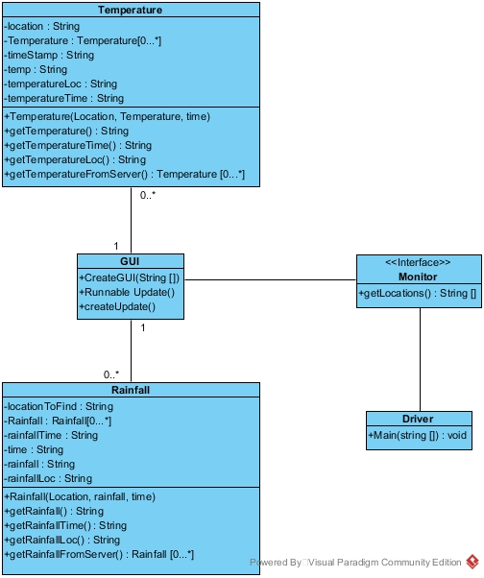

Class Diagram

Slide 11
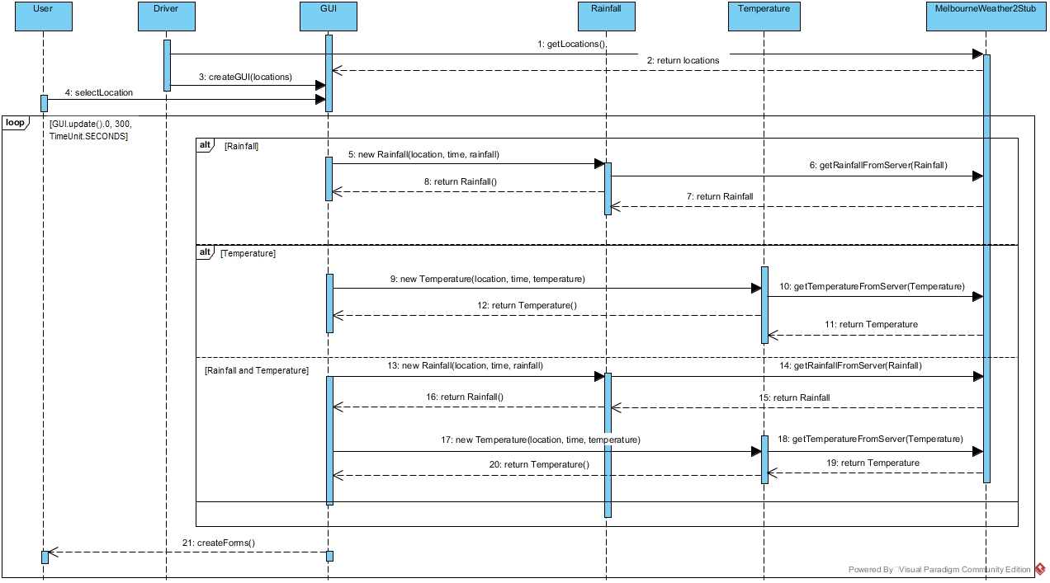
Sequence Diagram

